Slide 1
SIAM Business Meeting Financial Report 2021
Susan A. Palantino
Chief Operating Officer

Slide 2
2021 Revenue

Slide 3
2021 Expenses

Slide 4
2021 Expenses (by Function)

Slide 6
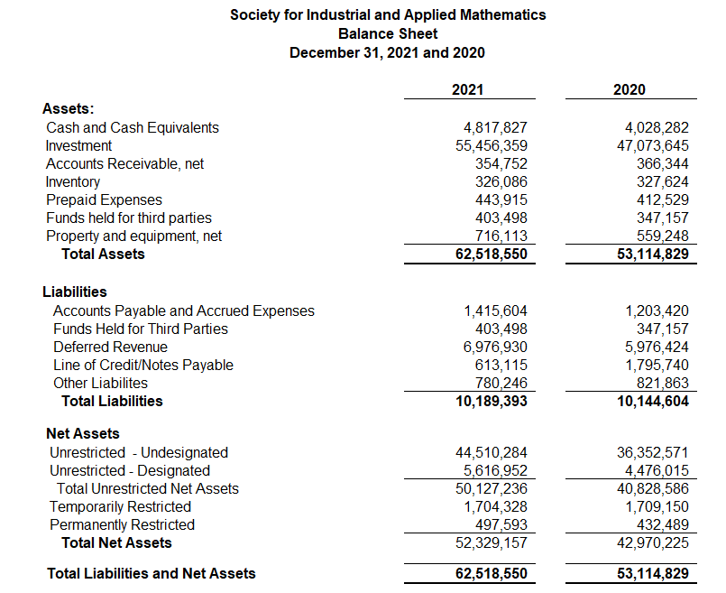

Slide 7
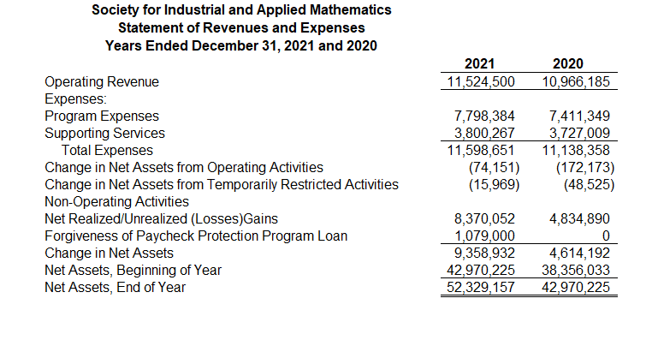

Slide 8
